Slide 1


Student Details
Name: Venkatesh nalla
Skillsbuild eMail ID: venkynalla021@gmail.com
College: Godavari institute of engineering and technology
Internship domain: Cyber security
Internship start and end dates: 07-06-2023 to 23-07-2023

Slide 2
Project Title: DOS Attack using NS2
Problem Statement:
This project aims to analyze and compare the effectiveness of different DoS attack mitigation techniques using NS2. By simulating various attack scenarios and implementing defense mechanisms, the study will provide insights into the optimal strategies for enhancing network resilience against DoS attacks. The outcomes will guide network administrators in making informed decisions to safeguard their networks from potential DoS threats.

Slide 3
AGENDA:
Introduction: Providing an overview of DoS attacks and the significance of studying their impact on networks using NS
Implementation of DoS Attack Scenarios: Simulating different types of DoS attacks in NS2, such as SYN flood, ICMP flood, and UDP flood.
Performance Evaluation: Analyzing network performance metrics during DoS attacks to assess their effects on the network.
Comparative Analysis of Defense Mechanisms: Comparing the effectiveness of various defense techniques, including rate limiting, traffic filtering, and anomaly detection.
Identifying Optimal Defense Strategy: Analyzing the results to determine the most efficient combination of defense mechanisms for enhancing network resilience against DoS attacks.

Slide 4
PROJECT OVERVIEW:
This project focuses on studying the behavior and impact of Denial-of-Service (DoS) attacks on networks using NS2 (Network Simulator 2). Through realistic simulations of various DoS attack scenarios, such as SYN flood, ICMP flood, and UDP flood, the research aims to evaluate the effects of these attacks on network performance metrics. Additionally, the project will explore and implement different defense mechanisms, including rate limiting, traffic filtering, and anomaly detection, to identify effective strategies for mitigating the impact of DoS attacks on the network. The outcomes of this research will contribute to enhancing network security and strengthening the resilience of networks against potential DoS threats.

Slide 5
END USERS of this project:
End Users for the project "DOS Attack using NS2" include:
Network Security Professionals
Academics and Students
Network Engineers and Researchers
Industries and Organizations
IT Managers and Decision Makers

Slide 6
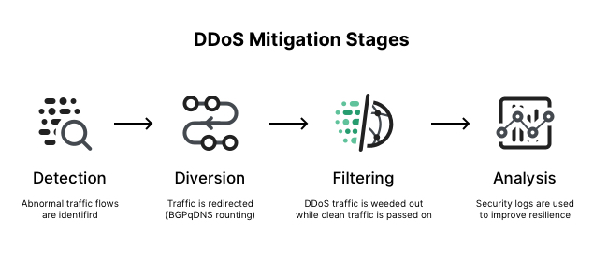
SOLUTION:
The solution involves simulating and analyzing Denial-of-Service (DoS) attacks using NS2 to evaluate their impact on network performance. Additionally, it implements various defense mechanisms, such as rate limiting, traffic filtering, and anomaly detection, to mitigate the effects of DoS attacks effectively.

Slide 7
VALUE PROPOSITION:
1. Comprehensive Understanding:
By simulating realistic DoS attack scenarios, the solution provides a comprehensive understanding of the behavior and consequences of such attacks on the network.
2. Optimal Defense Strategy:
Through comparative analysis, the solution identifies the most effective defense mechanisms, enabling network administrators to implement the best strategy to protect against DoS threats.
Overall, the project's end users include professionals, researchers, decision-makers, and organizations involved in the realm of network security, all seeking to bolster their network defenses against DoS attacks and secure their critical services and resources.

Slide 8
Customizations in the project:
Define Objectives:
Clearly outline your research objectives and the specific focus of your study on DoS attacks. Decide on the scope and depth of the project.
Select Attack Scenarios:
Choose the DoS attack scenarios you want to simulate based on your research interests and relevance to real-world scenarios.
Customize Network Topology:
Tailor the network topology in NS2 to reflect the characteristics of the network you want to study. Adjust the number of nodes, links, and their connections accordingly.
Implement Defense Mechanisms:
Select and implement specific defense mechanisms that you want to evaluate in NS2. Experiment with various configurations to assess their effectiveness.
By following these steps, we can customize the project to suit your research objectives and explore the specific aspects of DoS attacks and defense mechanisms that align with your interests.

Slide 9
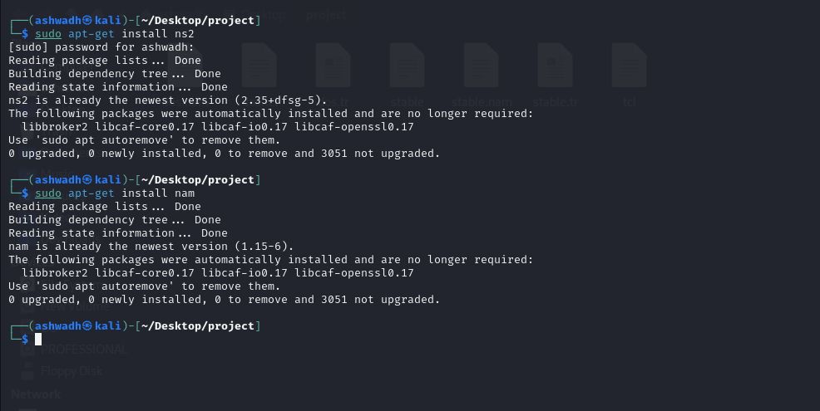
Installation of NS2 and NAM:

Slide 10
MODELLING:
Network Simulator 2 (NS2):
The core tool for simulating the network environment, defining topologies, and creating DoS attack models.
DoS Attack Models:
Models for SYN flood, ICMP flood, and UDP flood attacks to generate malicious traffic.
Defense Mechanism Implementations:
Implementing rate limiting, traffic filtering, and anomaly detection within NS2 to counteract DoS attacks.
Performance Metrics:
Evaluating network performance metrics like packet loss, throughput, latency, and QoS parameters during DoS attacks.
Comparative Analysis:
Comparing the effectiveness of defense mechanisms to identify optimal strategies for mitigating DoS attacks.

Slide 11
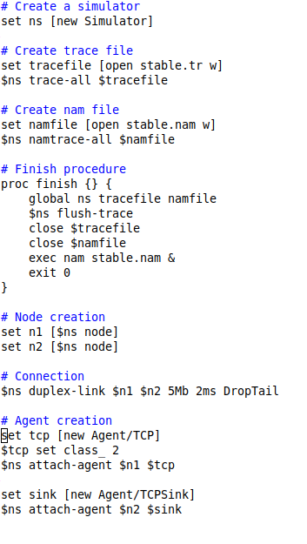
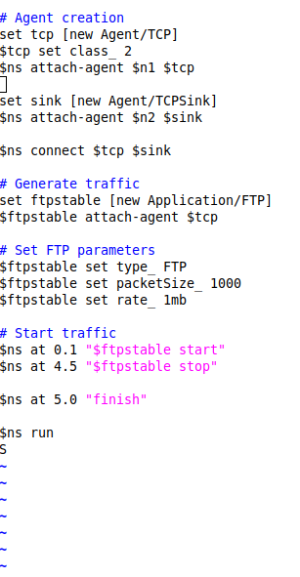
Code:

Slide 12
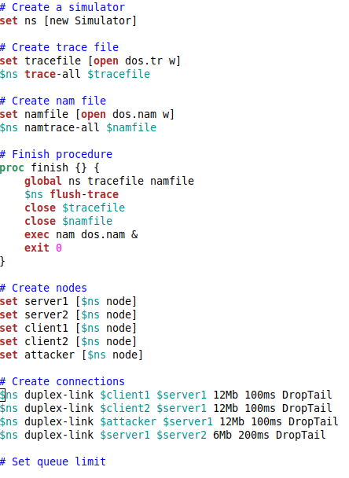
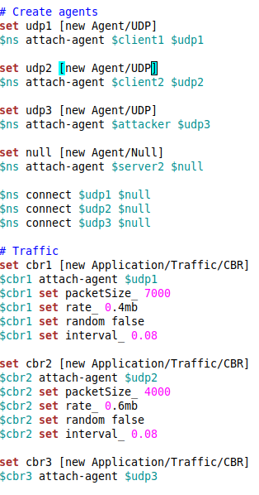
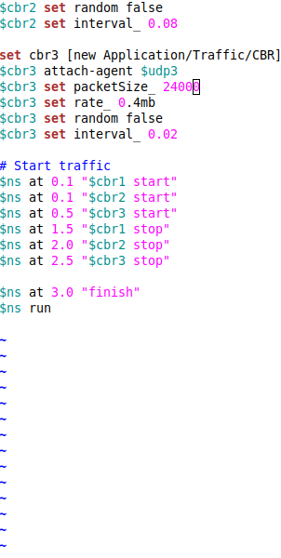

Slide 13
Results:
Impact of DoS Attacks:
Insights into the effects of different DoS attack scenarios on network performance metrics, such as increased packet loss, reduced throughput, and heightened latency.
Defense Mechanism Evaluation:
Comparative analysis of defense mechanisms, assessing their effectiveness in mitigating DoS attacks and their impact on network performance during attacks.
Optimal Defense Strategy:
Identification of the most effective combination of defense mechanisms based on the research findings and performance metrics analysis.
Recommendations:
Actionable recommendations to enhance network security and resilience against DoS attacks, based on the study's outcomes and insights.
The results of the project would contribute to a better understanding of DoS attacks and the development of effective defense strategies to protect network infrastructures from potential threats

Slide 14
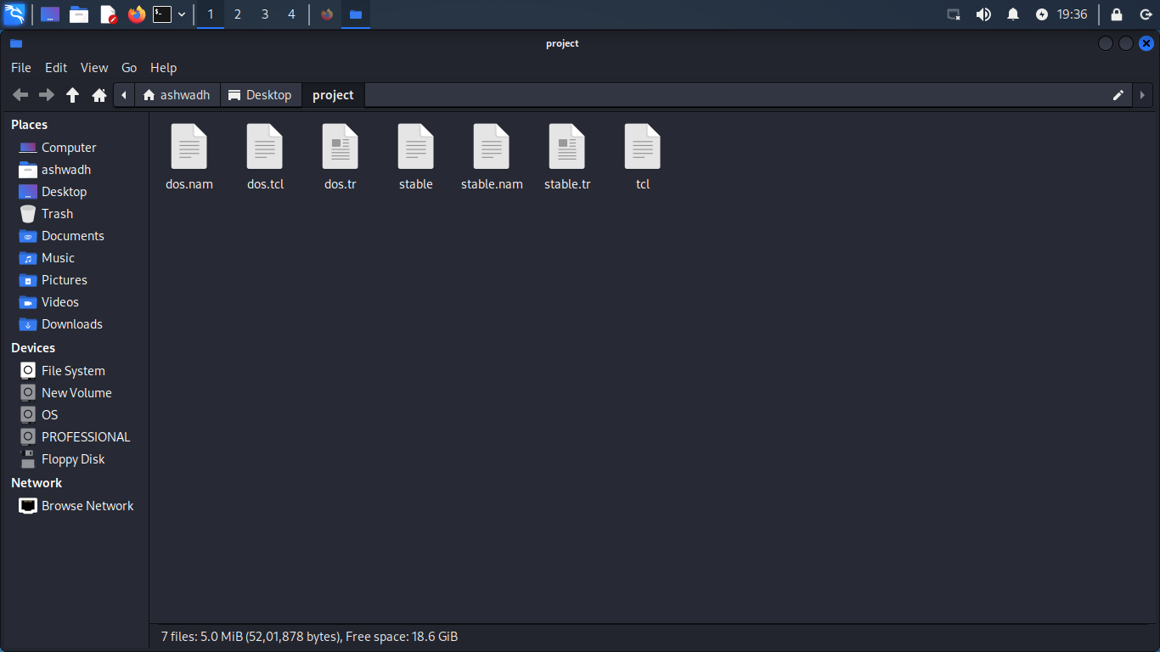
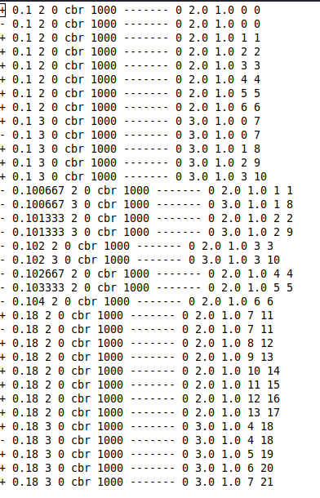
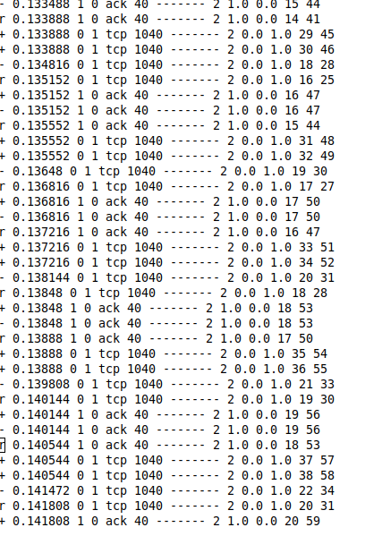
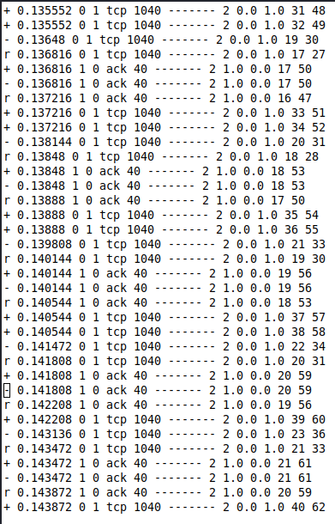
Result Screen Shorts:

Slide 15
links
Reference: https://skillsbuild.edunetworld.com/courses/cs/dos-attack-using-ns2/
Github: https://github.com/inikhil/DoS-Attacks-Using-Network-Simulator
Other references:
https://networksimulator2.com/ns2-ddos-attack/
https://ieeexplore.ieee.org/abstract/document/7876739

